Slide 1
CSC-257 Theory Of Computation (BSc CSIT, TU)
Ganesh Khatri
kh6ganesh@gmail.com

Slide 2
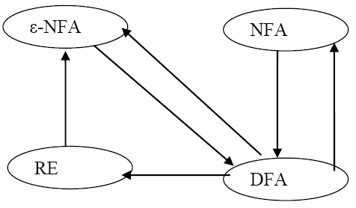
Finite Automata and Regular expressions
The regular expression approach for describing language is fundamentally different from the finite automaton approach.
However, these two notations turn out to represent exactly the same set of languages, which we call regular languages
In order to show that the RE define the same class of language as Finite automata, we must show that :
Any language defined by one of these finite automata is also defined by RE.
Every language defined by RE is also defined by any of these finite automata
We can proceed as :

